Slide 1
Competitive Programming
24 May 2024

Slide 2
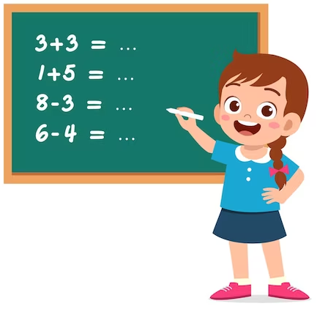
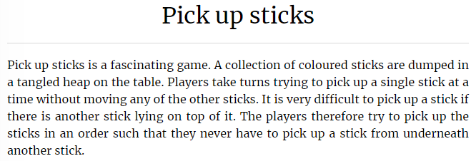
Practice - Pick Up Sticks
Kattis: https://open.kattis.com/problems/pickupsticks
Task ID: pickupsticks

Slide 3
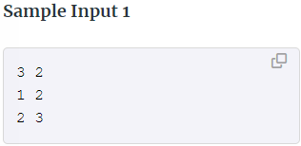
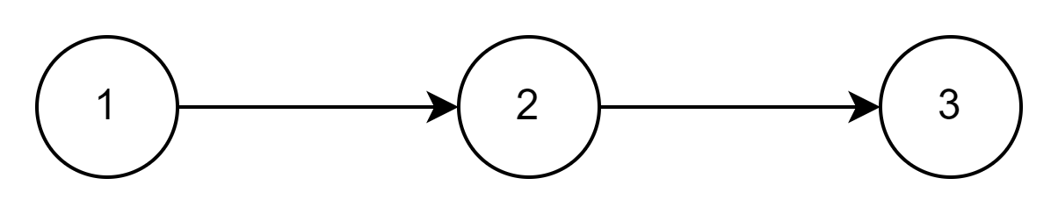
Practice - Pick Up Sticks
Visualize the input and identify what kind task it is.
We need to take stick which are on the top only!
We need to take nodes without incoming connections
We need to apply topological sort algorithm
Be careful, it might impossible
Loop detection is required here as well

Slide 4
Practice - Pick Up Sticks
Kattis: https://open.kattis.com/problems/pickupsticks
Task ID: pickupsticks
Solve the problem by applying topological sort and make sure that there is no loop in the graph.

Slide 5
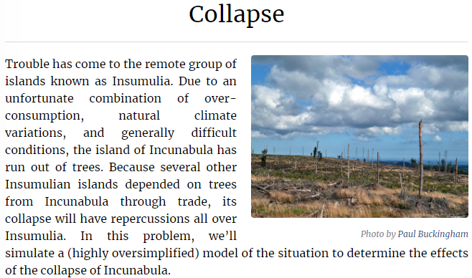
Practice - Collapse
Kattis: https://open.kattis.com/problems/collapse
Task ID: collapse
Topological sorting based on other values, not on graph structure (edges).

